Slide 1
Optimized Conformers Under Global & Local Parameters

Slide 2
Global Definition 1
Global optimum is the average position of all the local optima

Slide 3
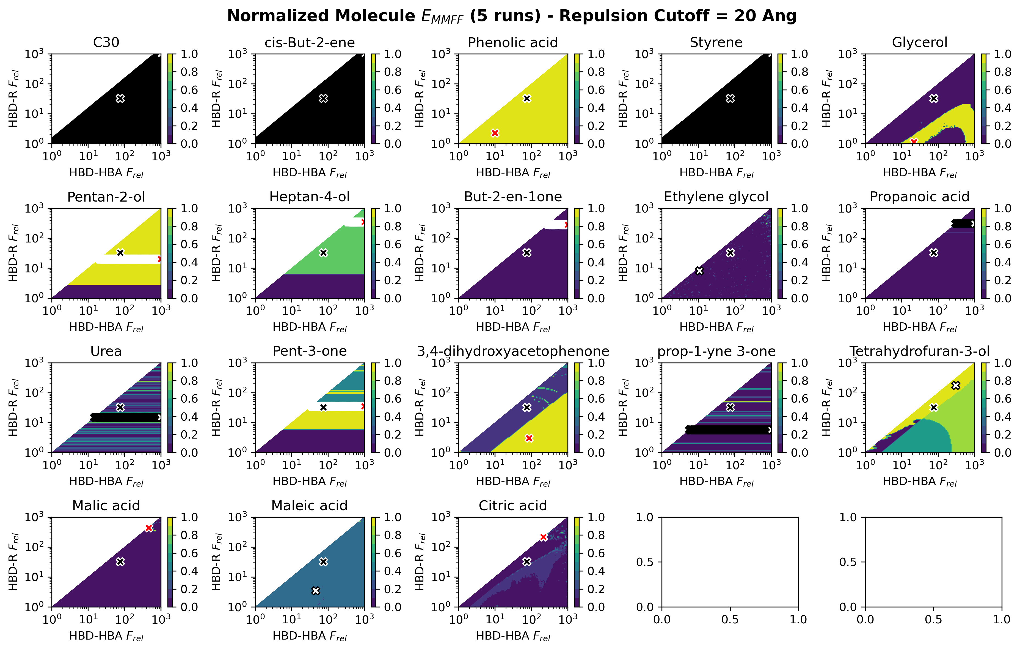

Slide 4
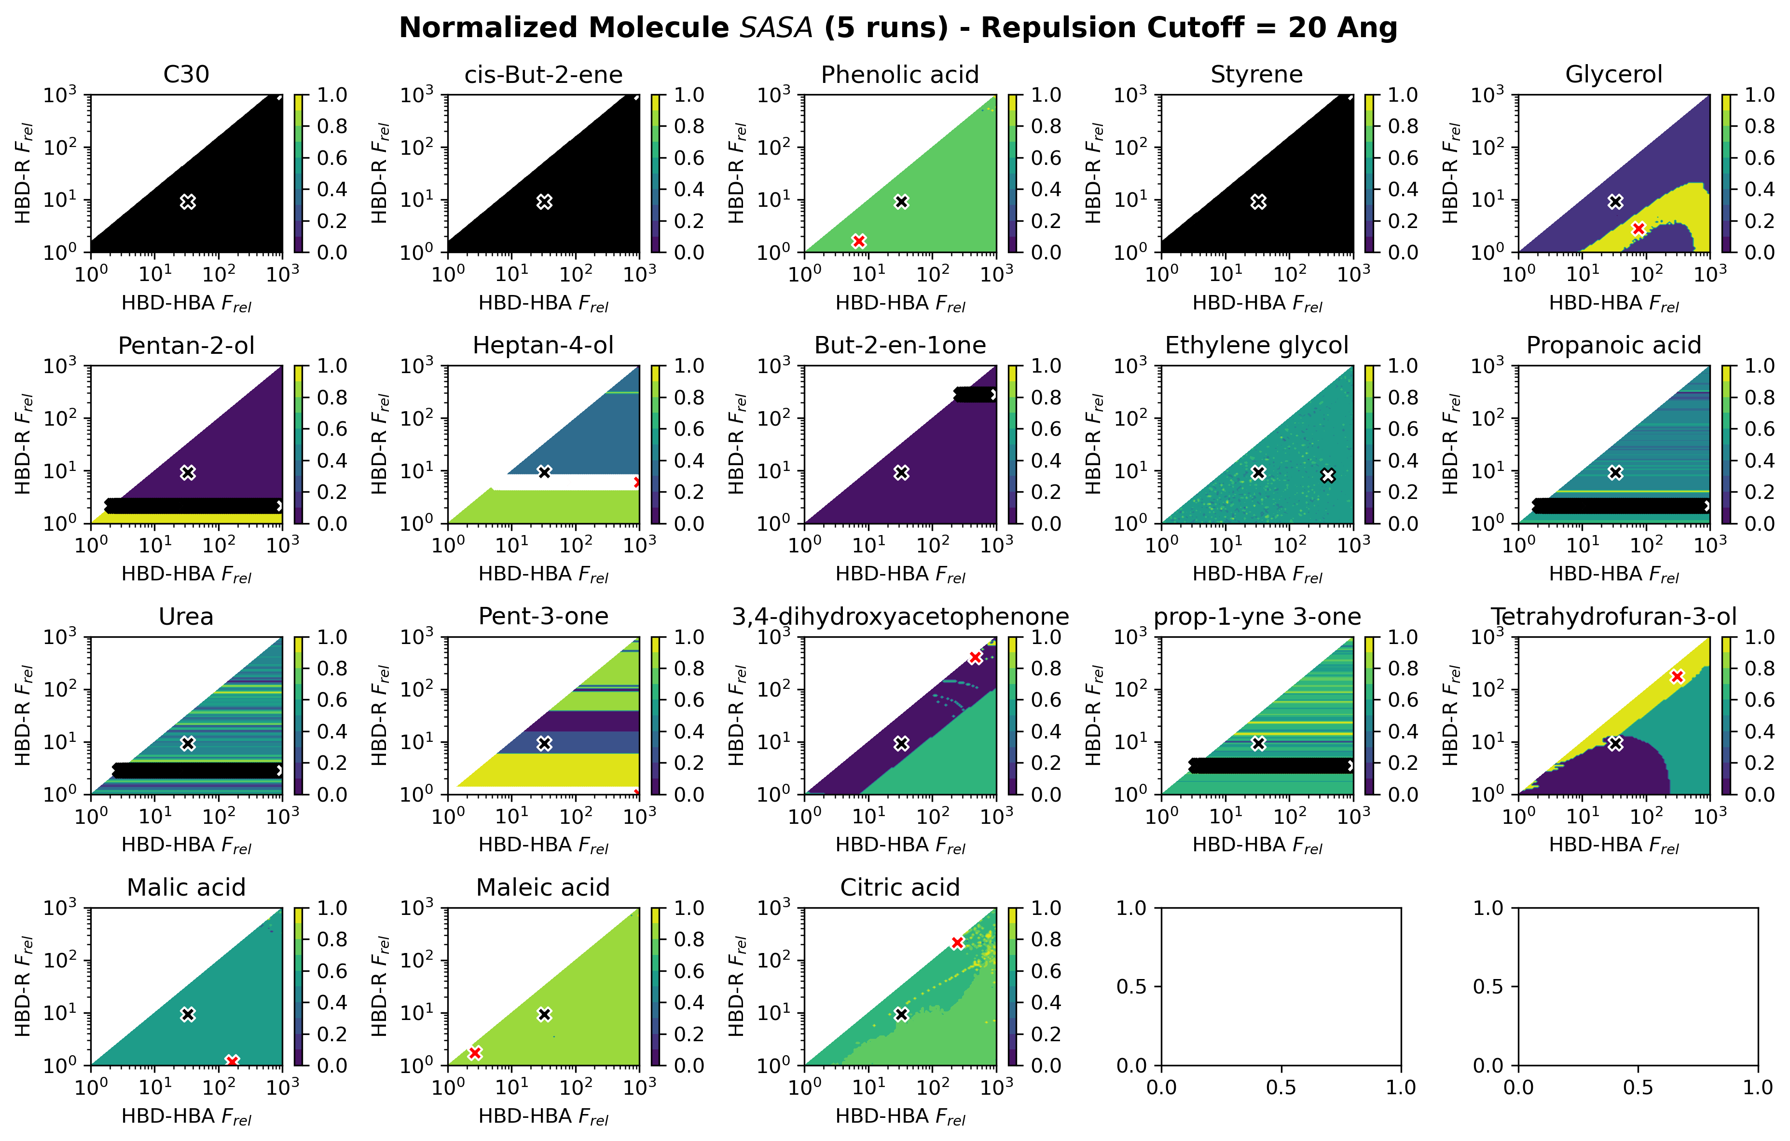

Slide 5
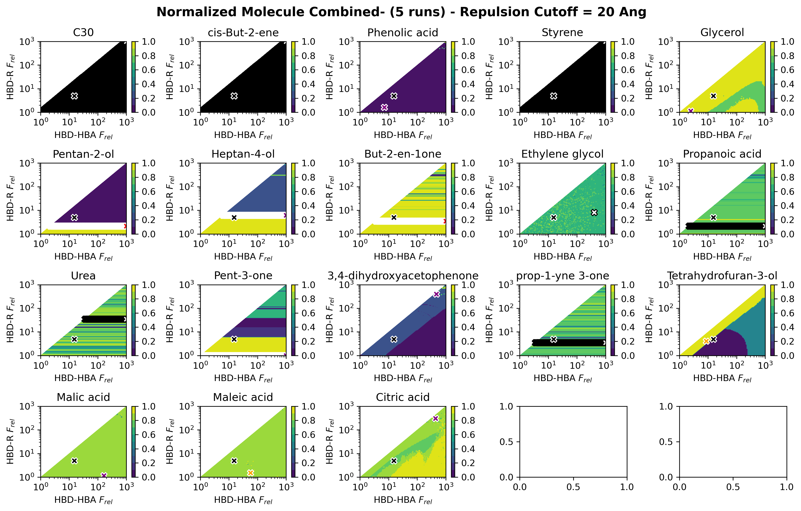

Slide 6
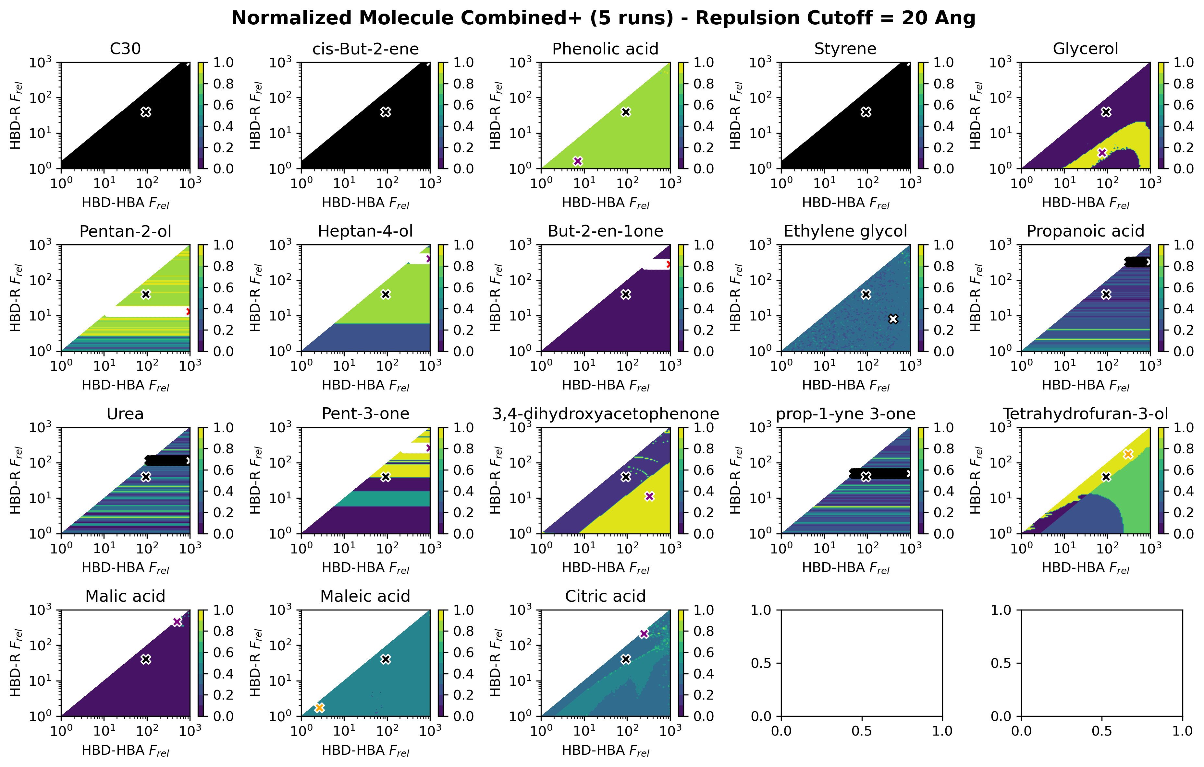

Slide 7
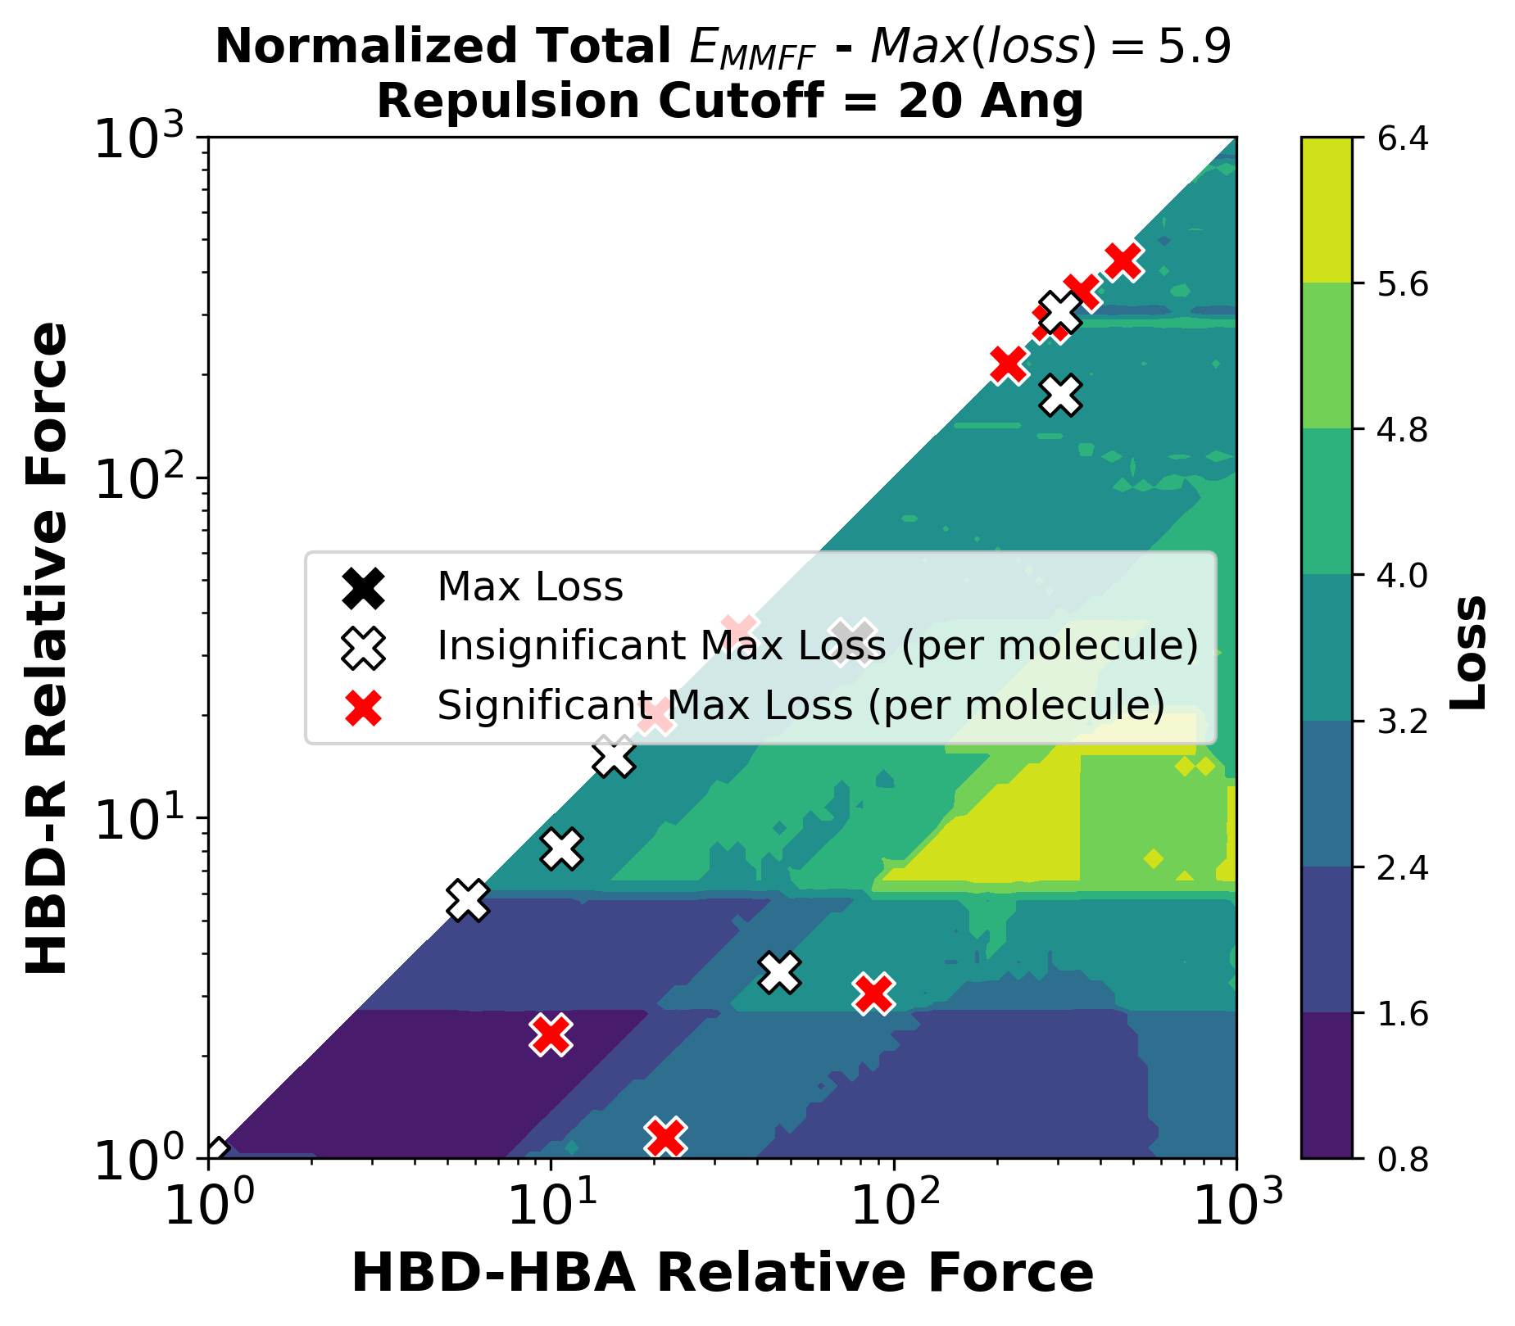
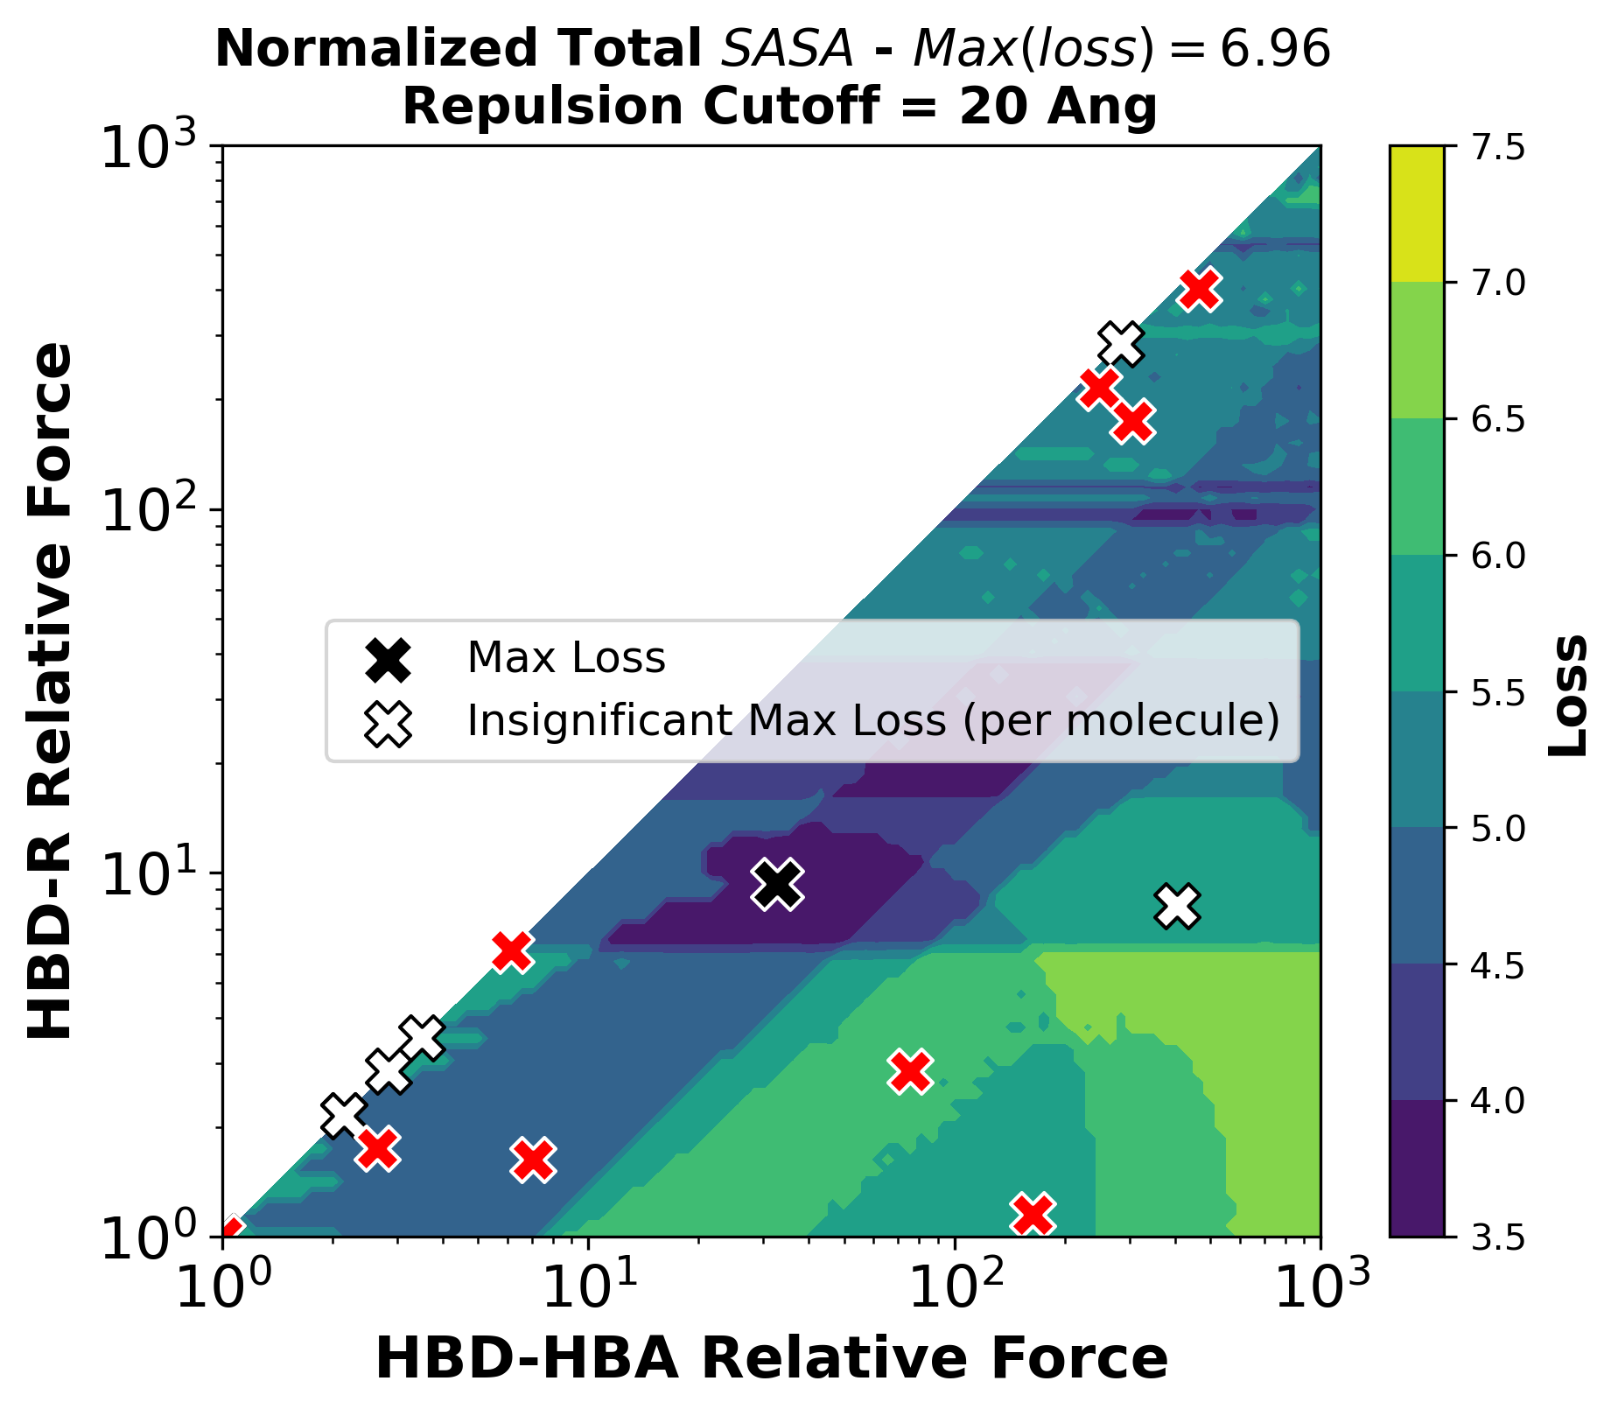
Separate Loss Functions

Slide 8
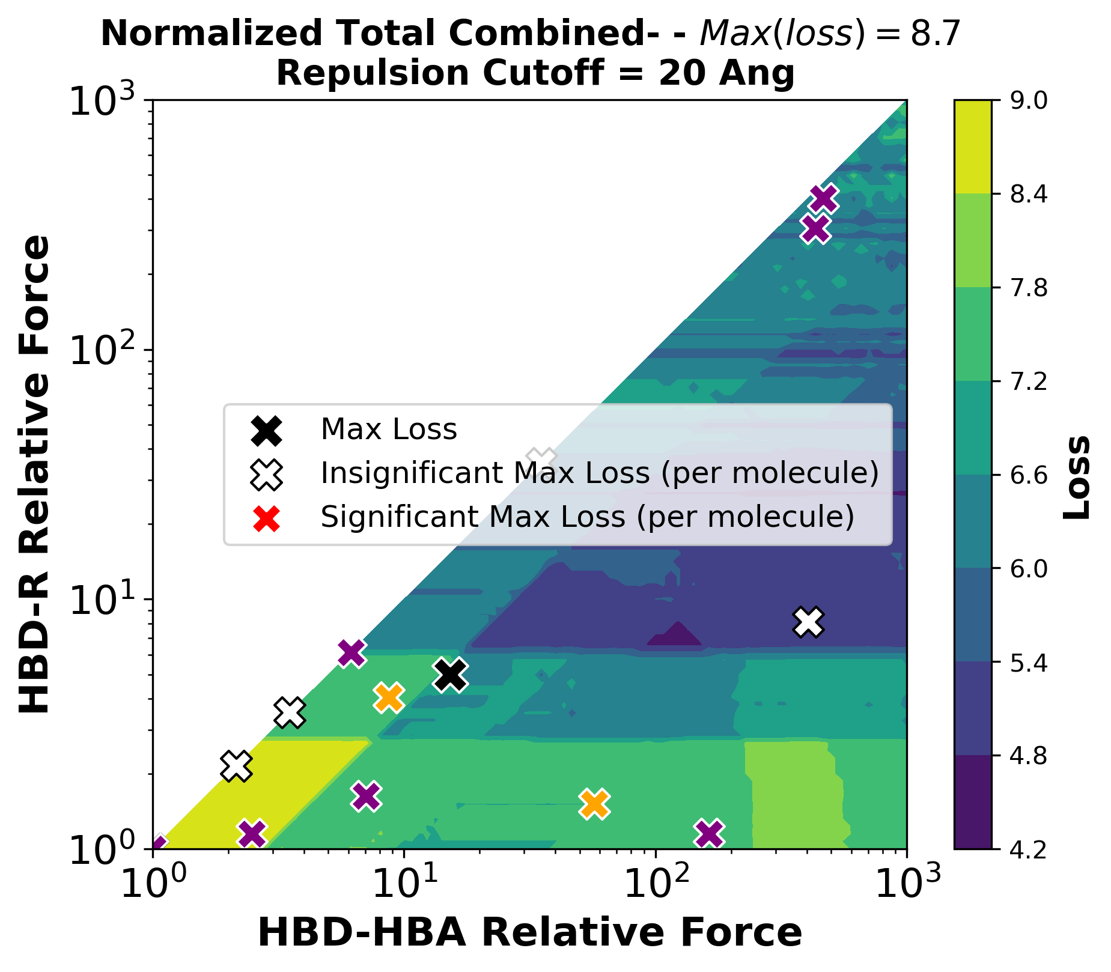
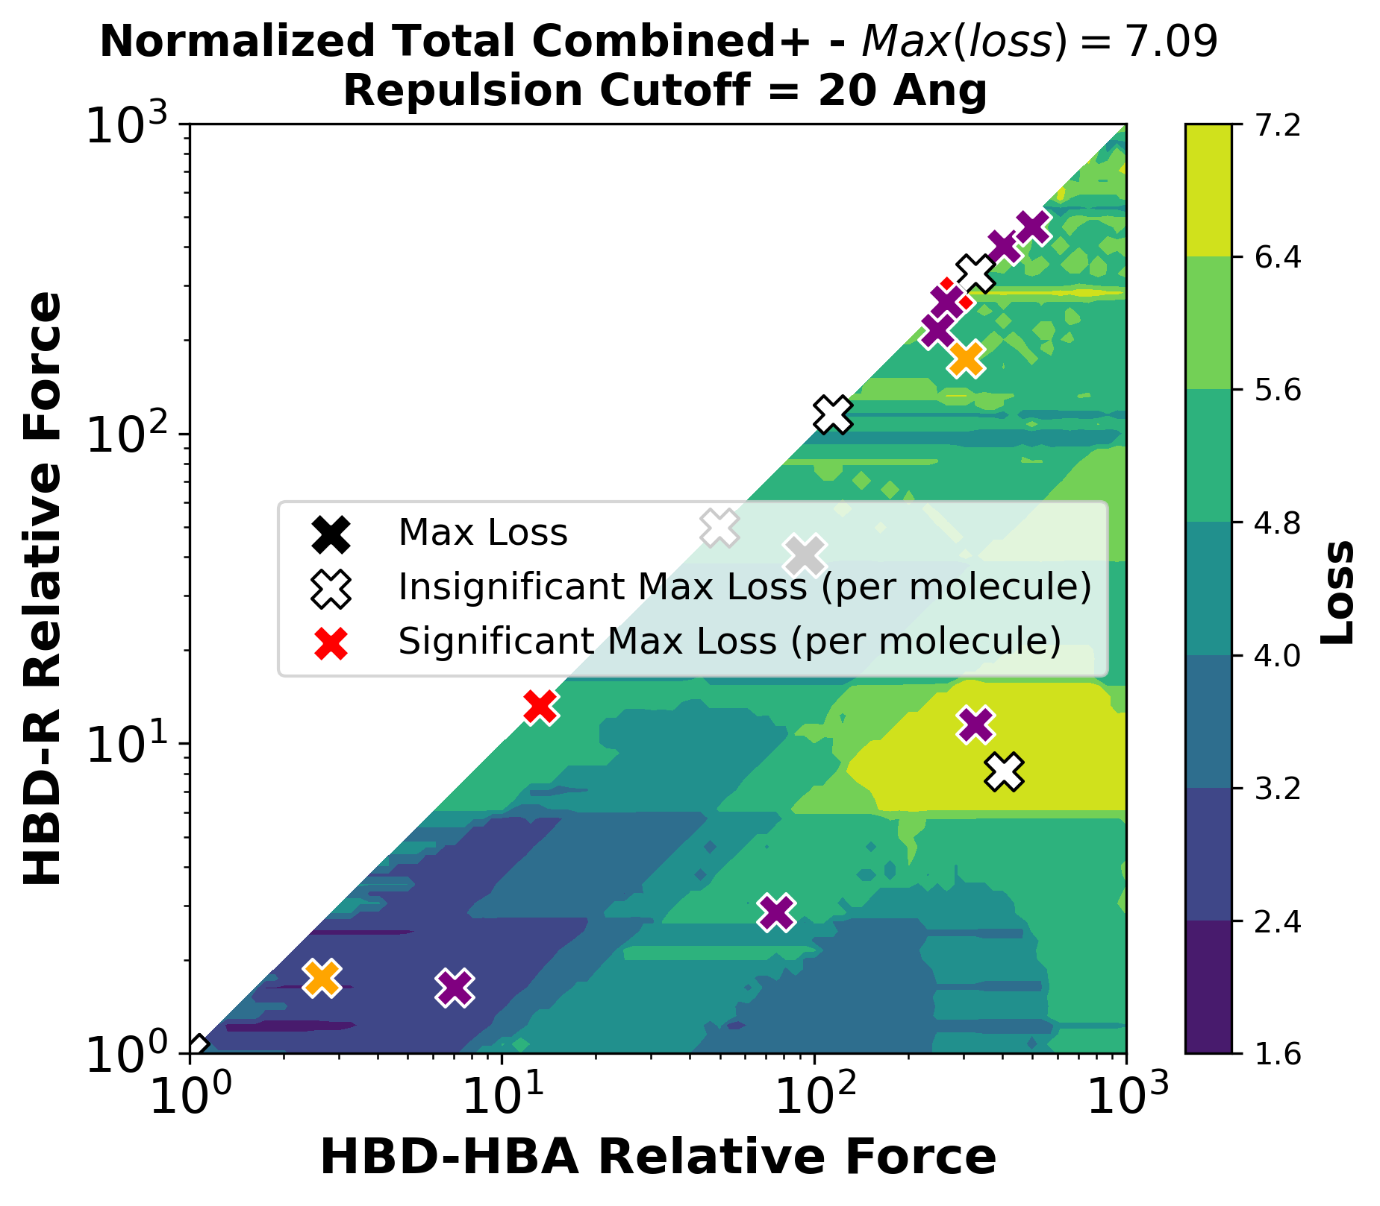
Combined Loss Functions

Slide 9
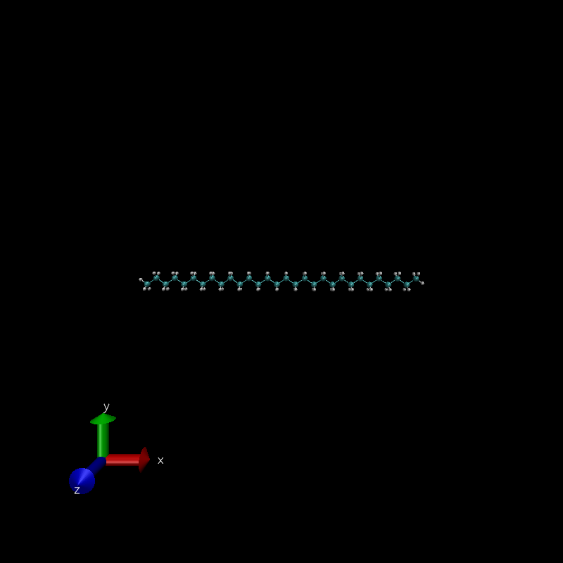
C30

Slide 10
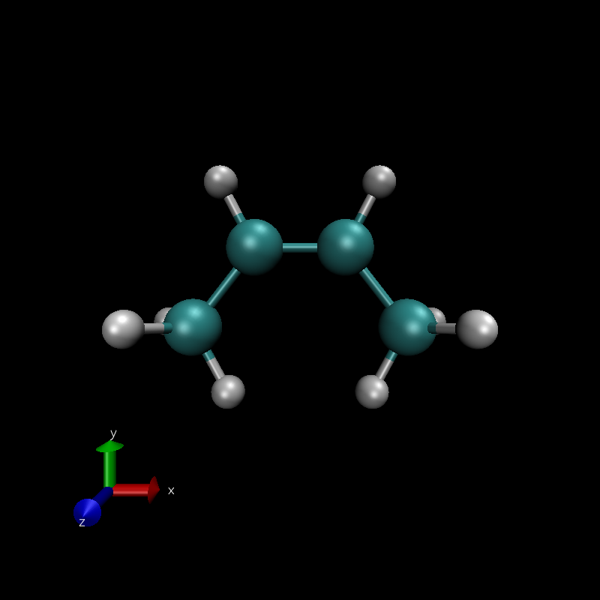
cis-But-2-ene

Slide 11
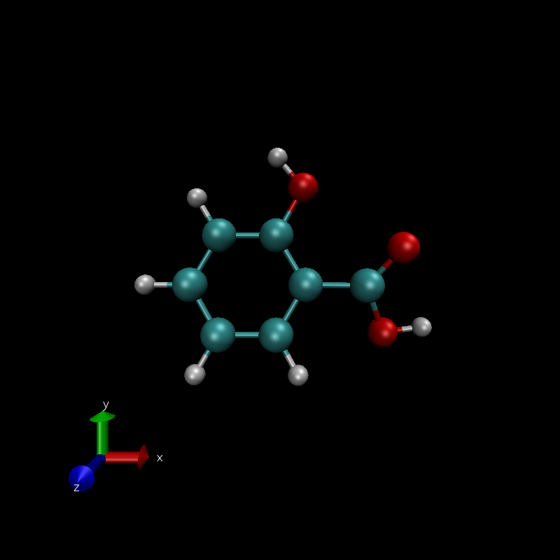





Phenolic acid

Slide 12
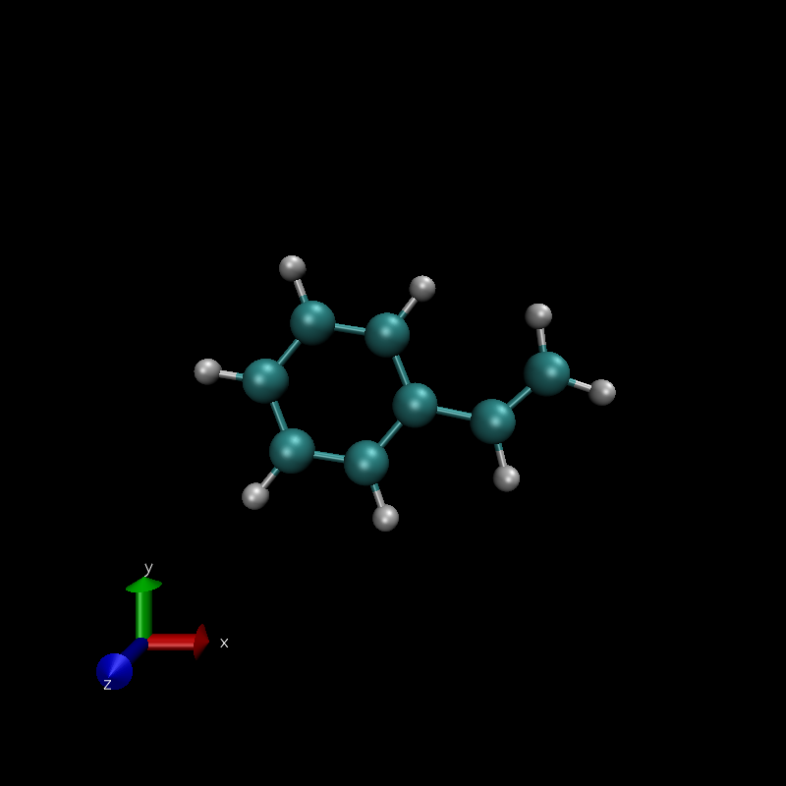
Styrene

Slide 13
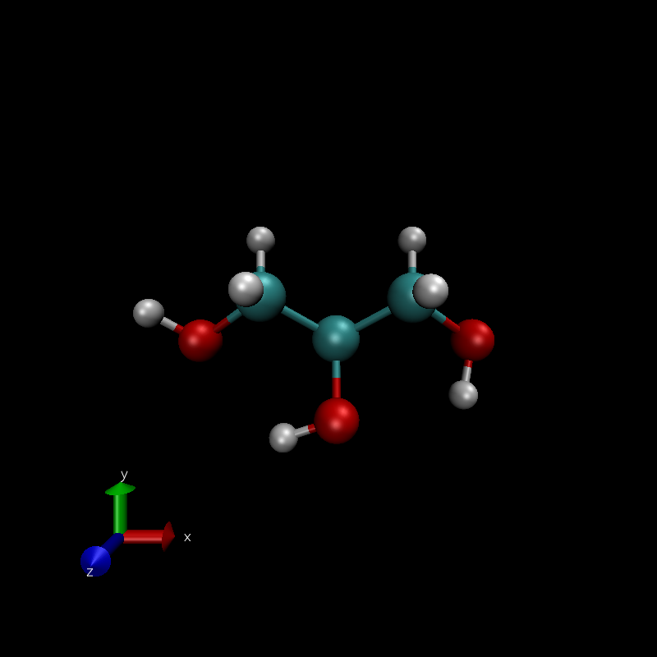
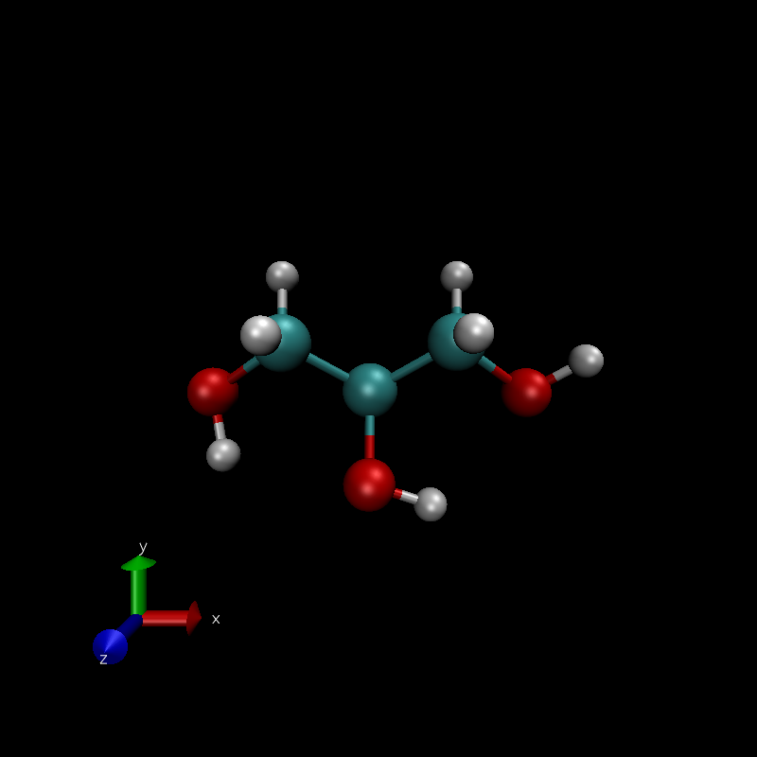


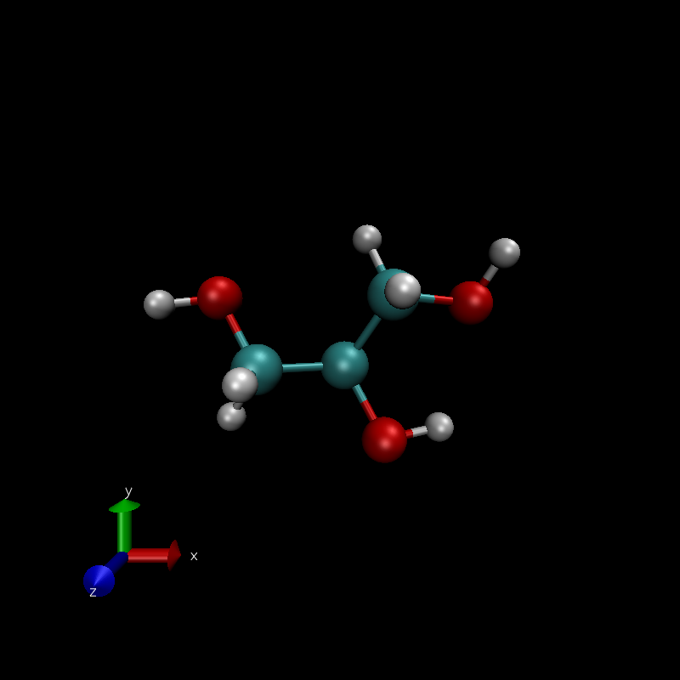

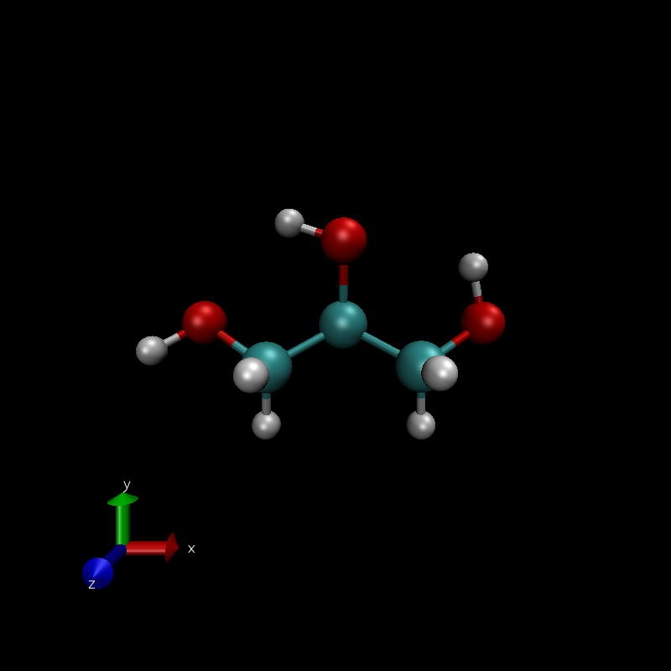
Glycerol

Slide 14
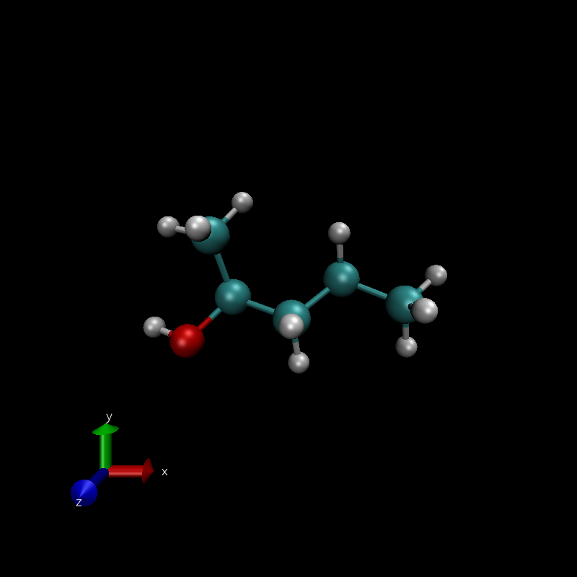




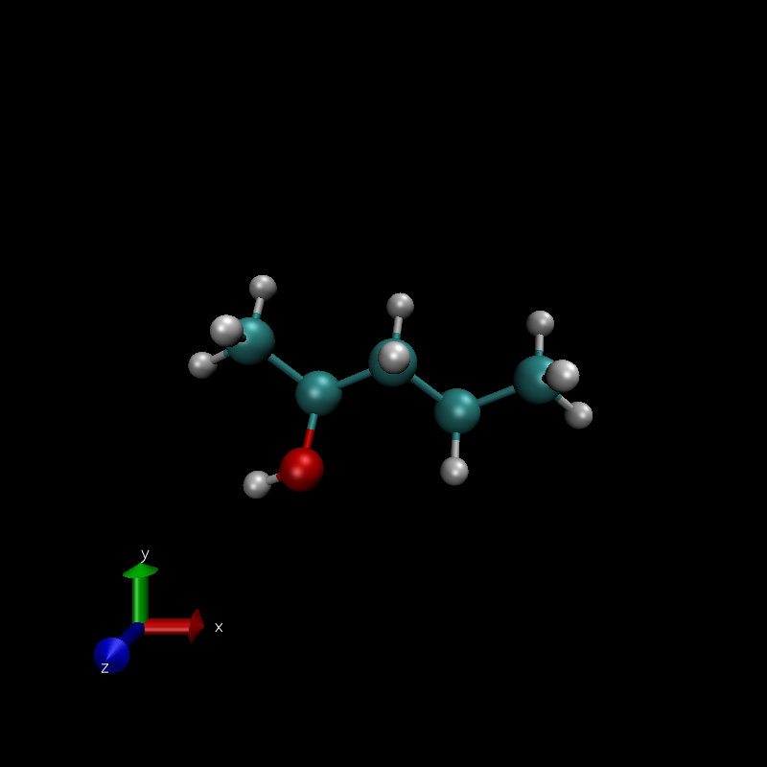

Pentan-2-ol

Slide 15
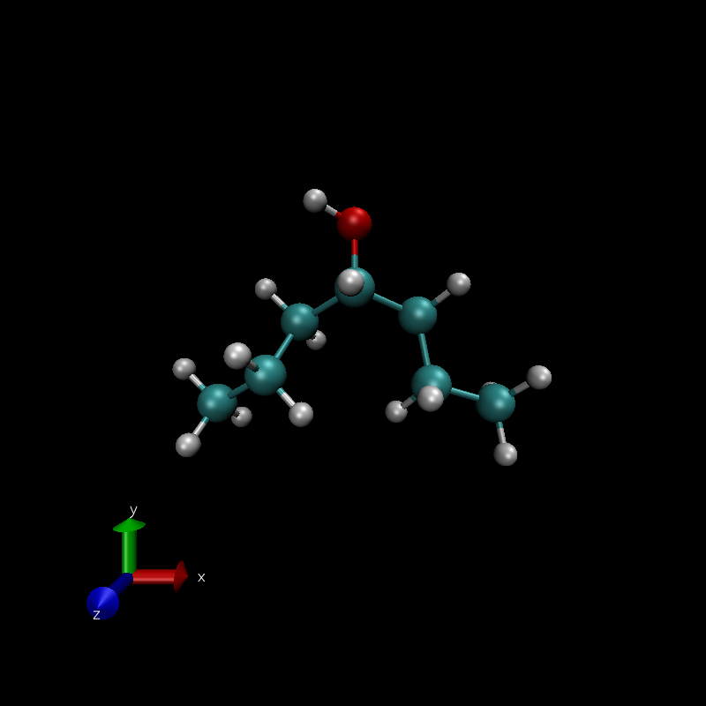
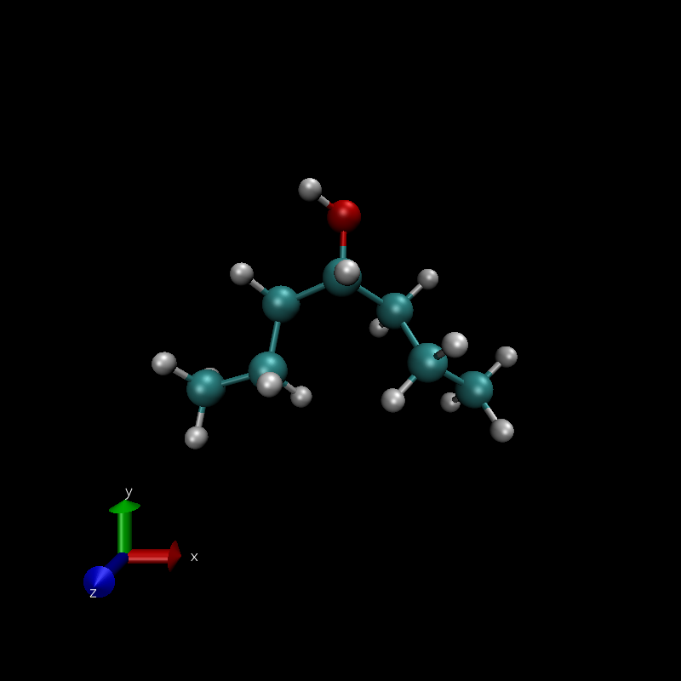
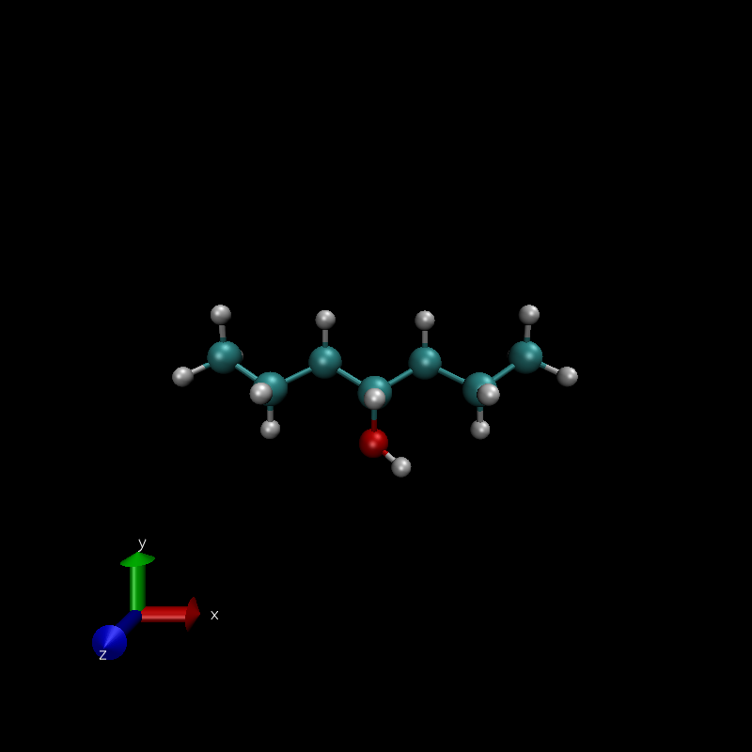
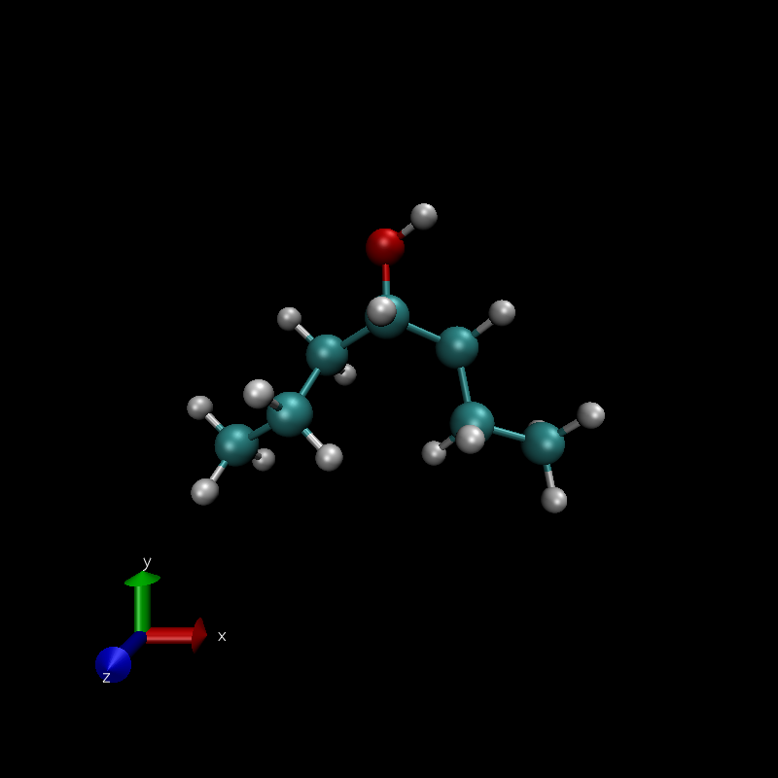
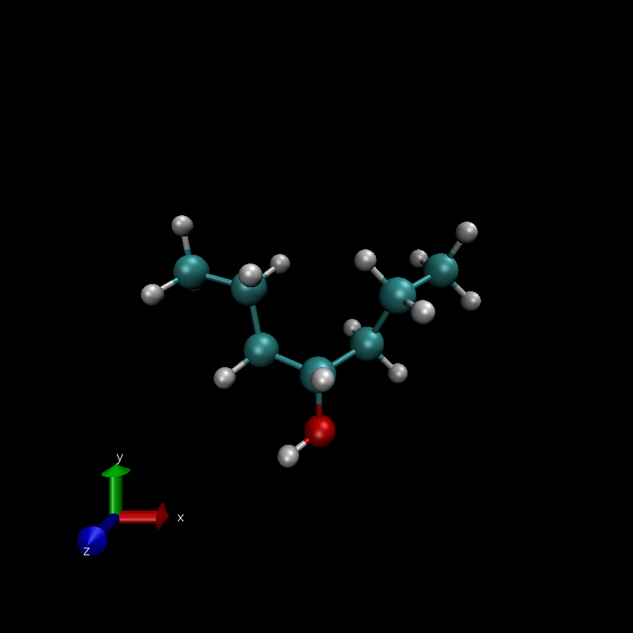
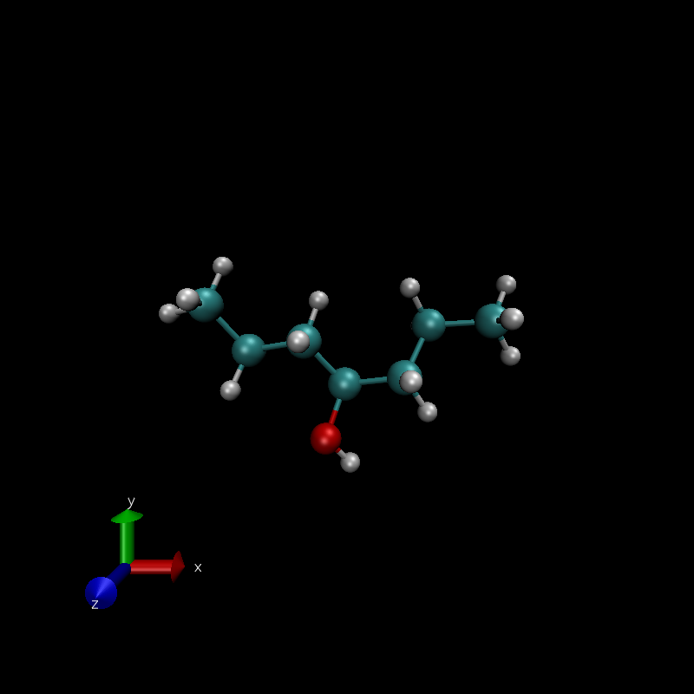

Heptan-4-ol

Slide 16
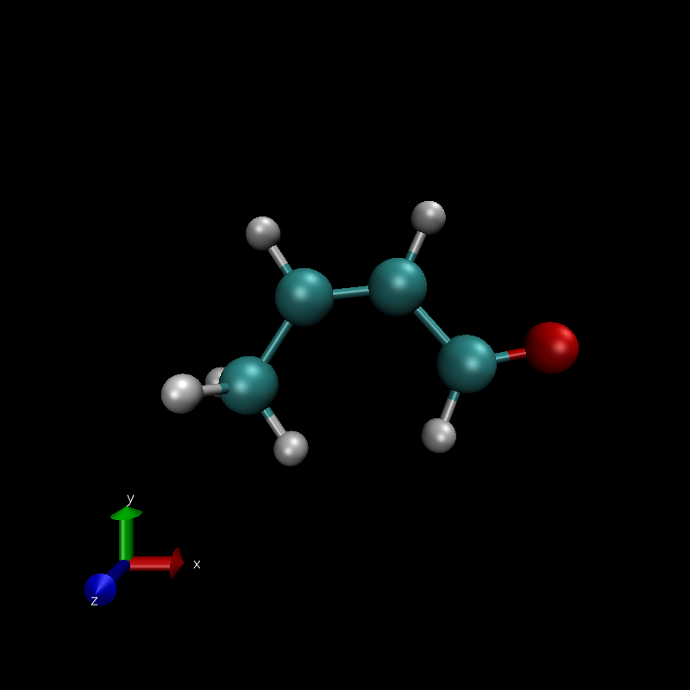





But-2-en-1one

Slide 17
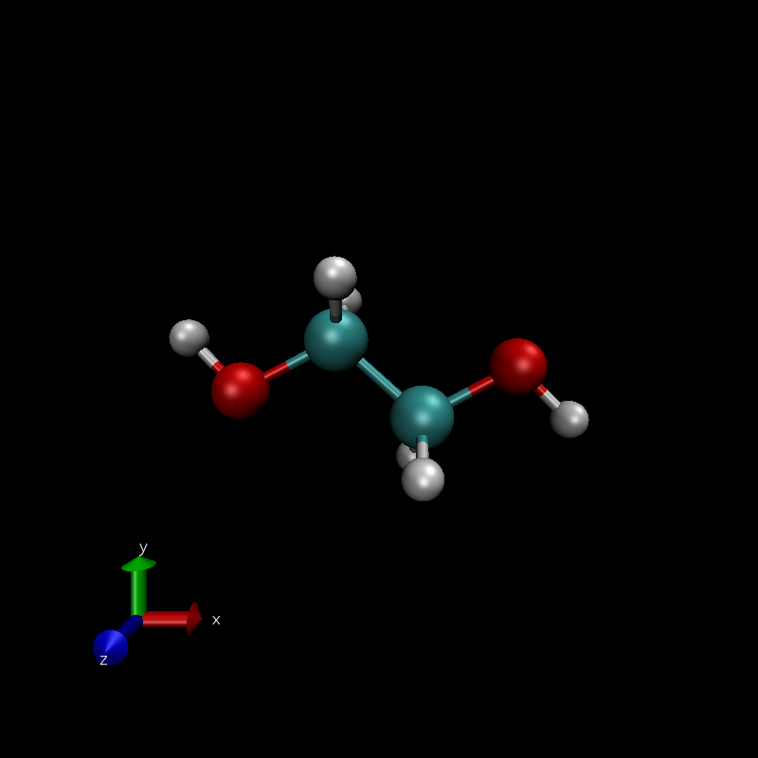





Ethylene glycol

Slide 18
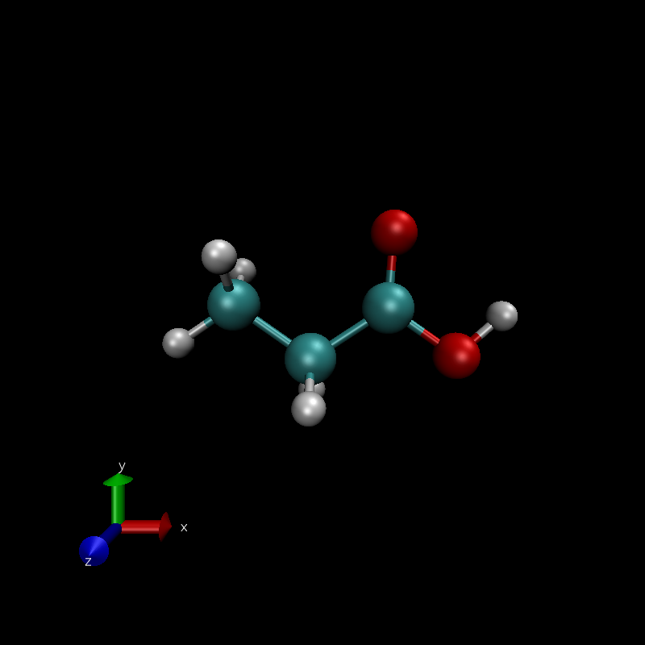






Propanoic acid

Slide 19
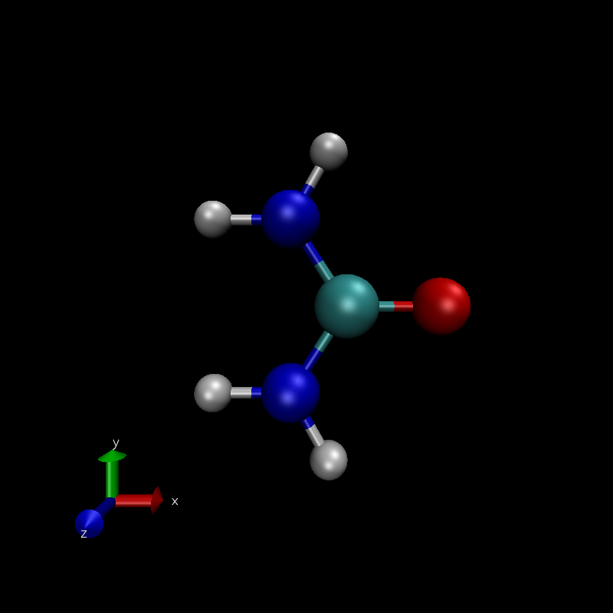

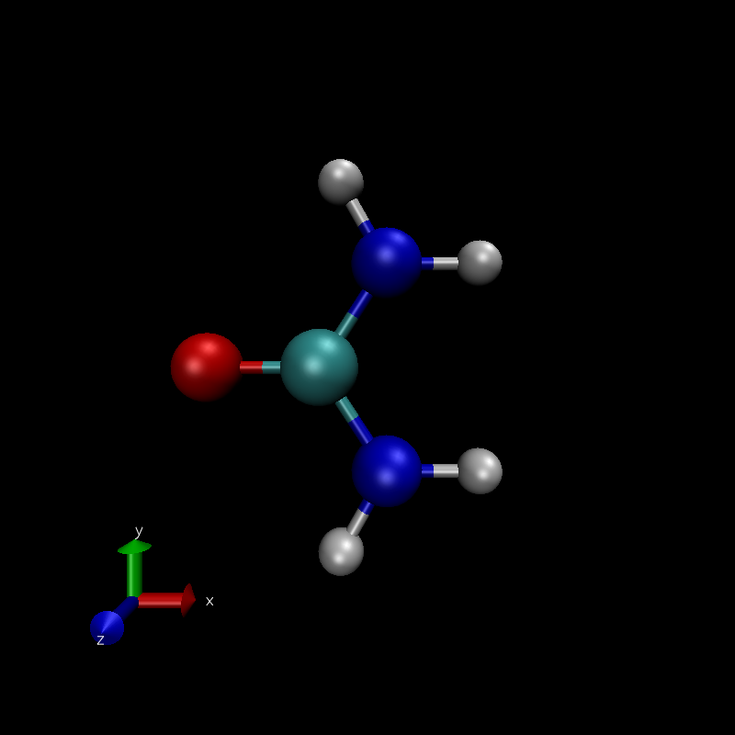





Urea

Slide 20
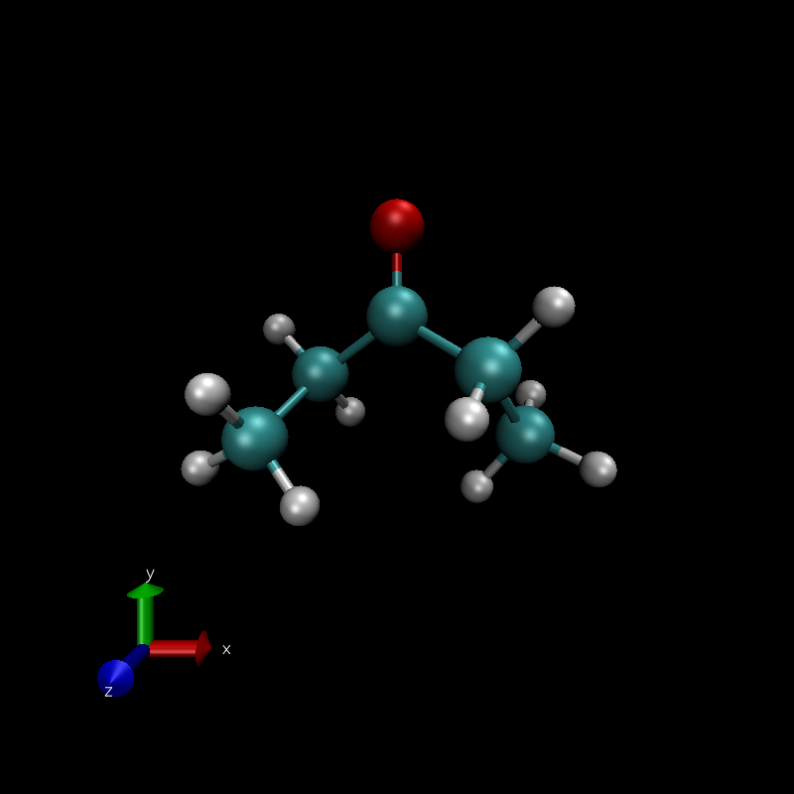
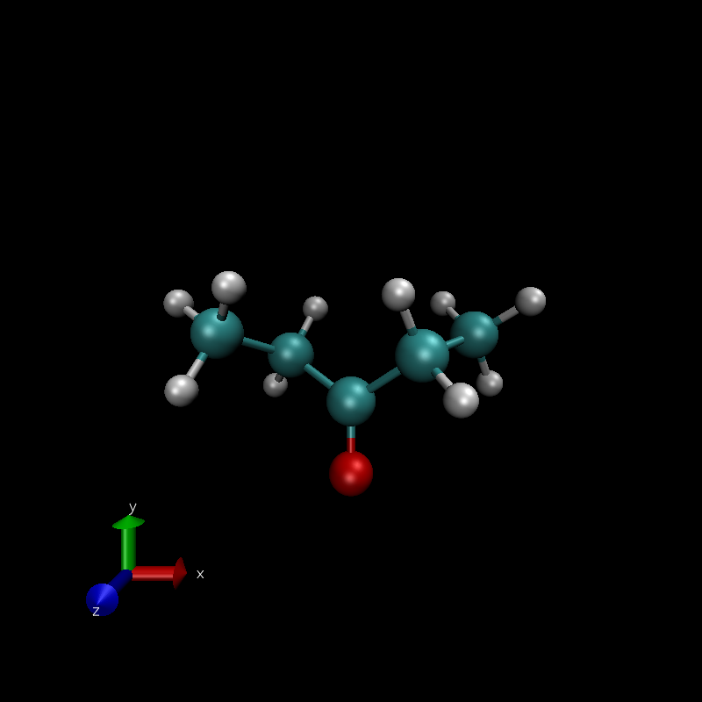
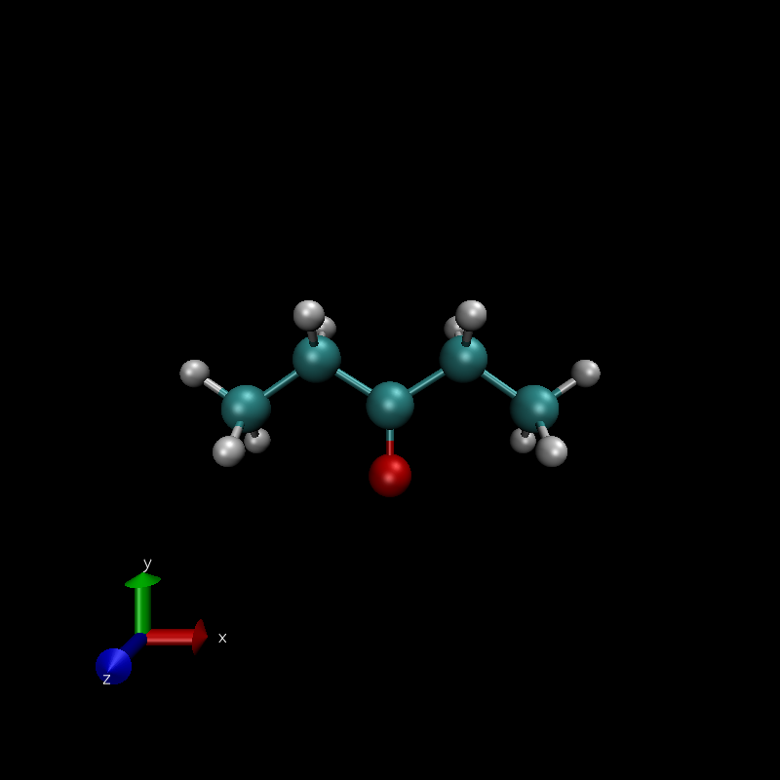
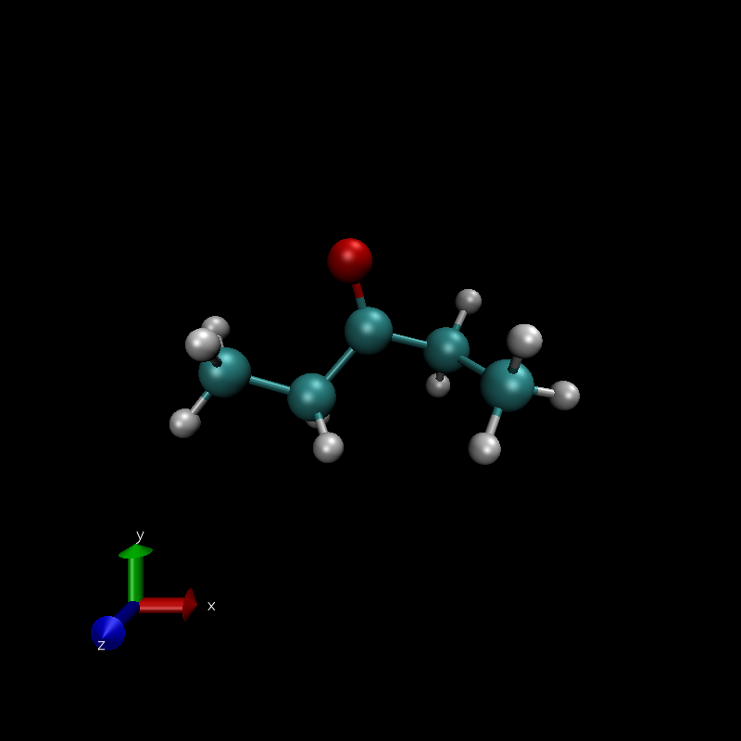
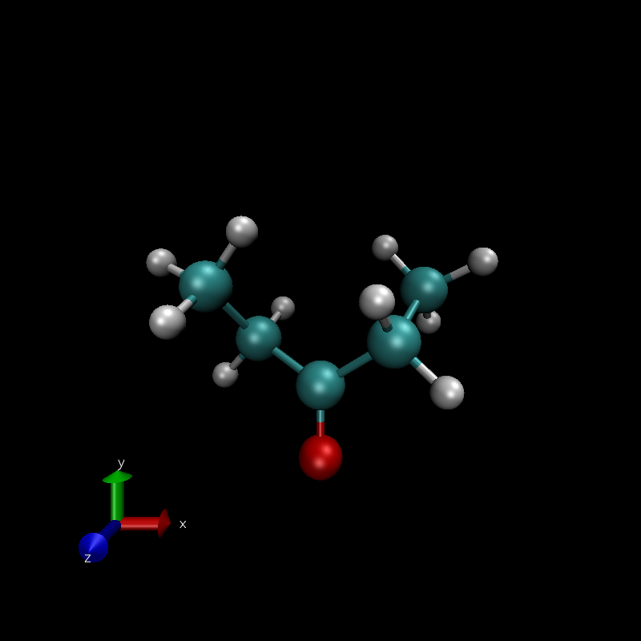

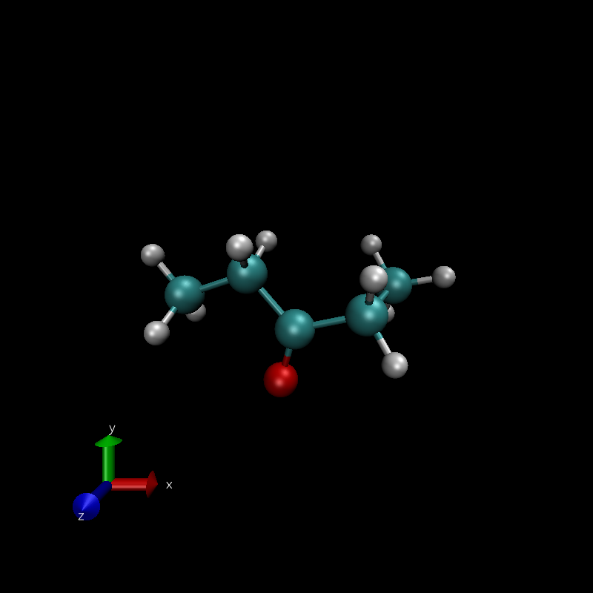
Pent-3-one

Slide 21
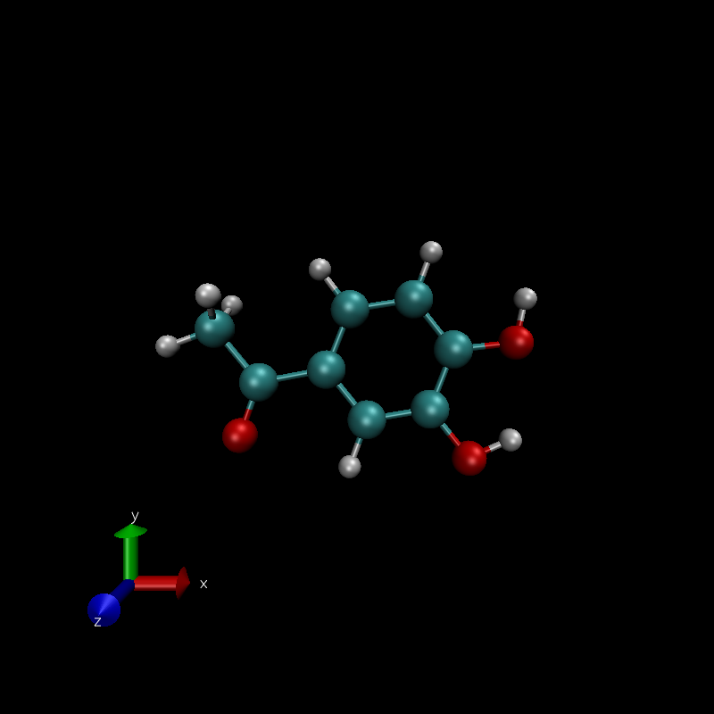



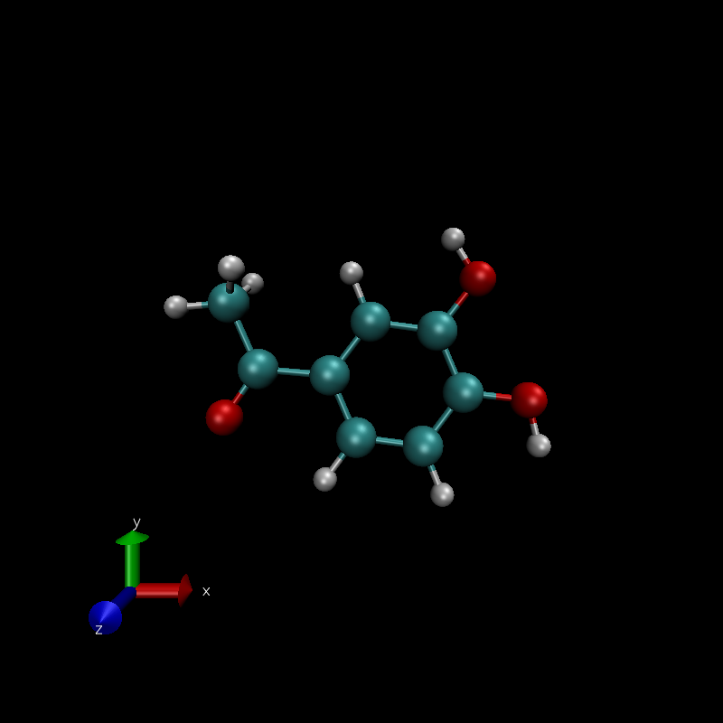


3,4-dihydroxyacetophenone

Slide 22
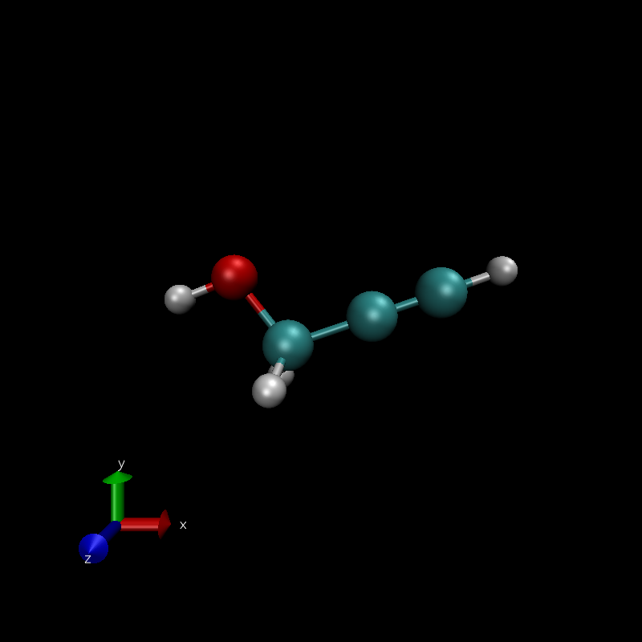






prop-1-yne 3-one

Slide 23
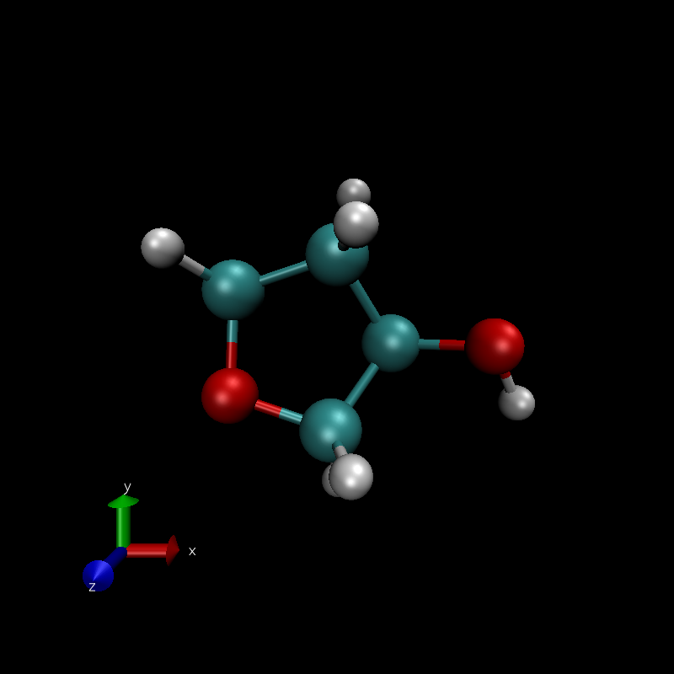
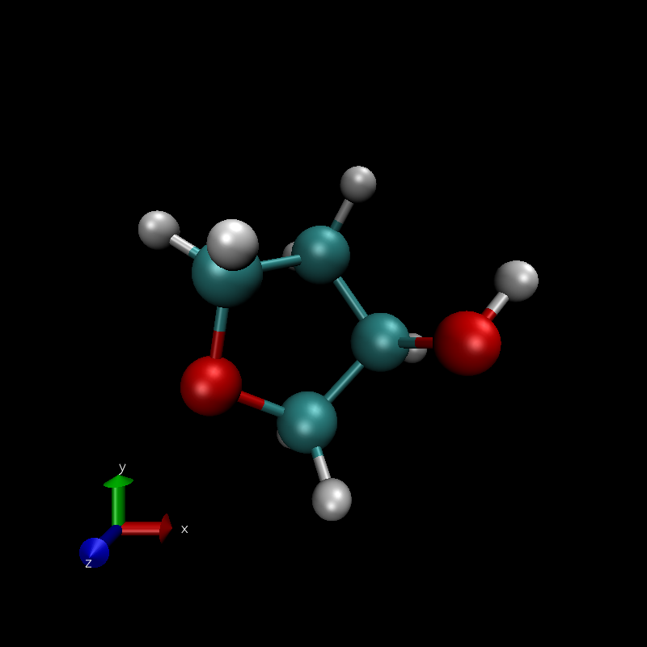



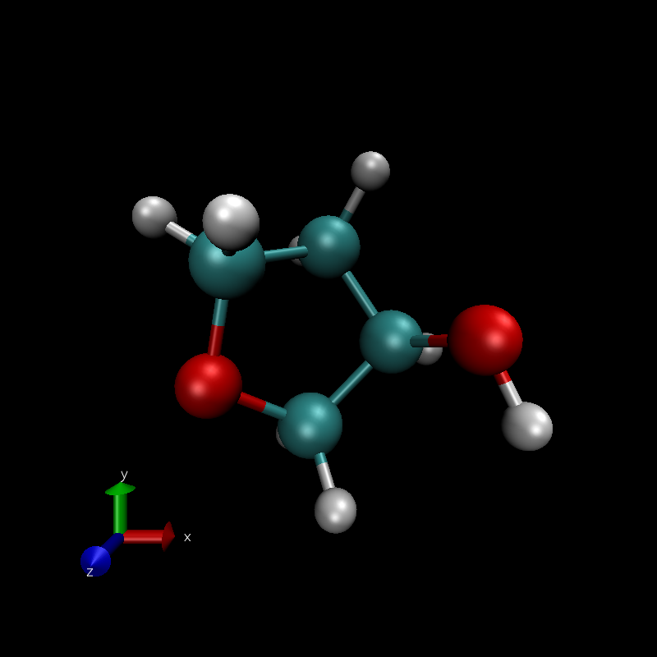
Tetrahydrofuran-3-ol

Slide 24
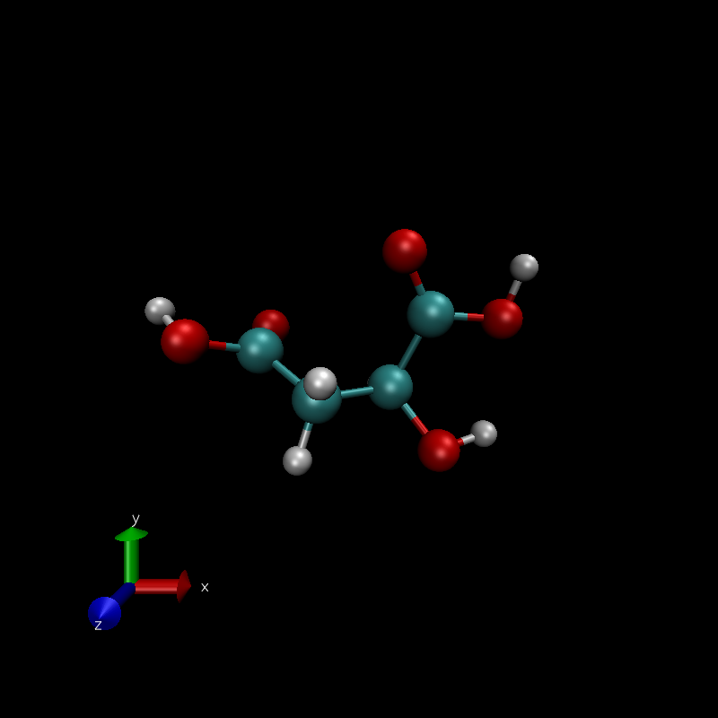



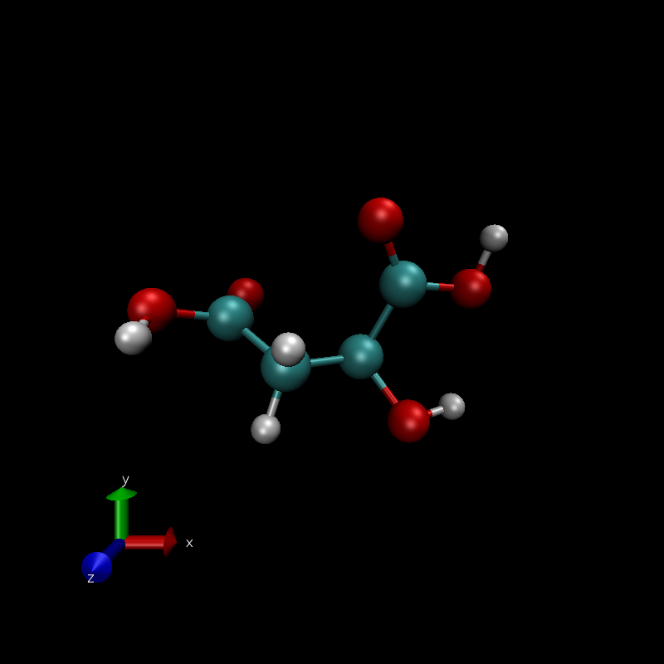


Malic acid

Slide 25
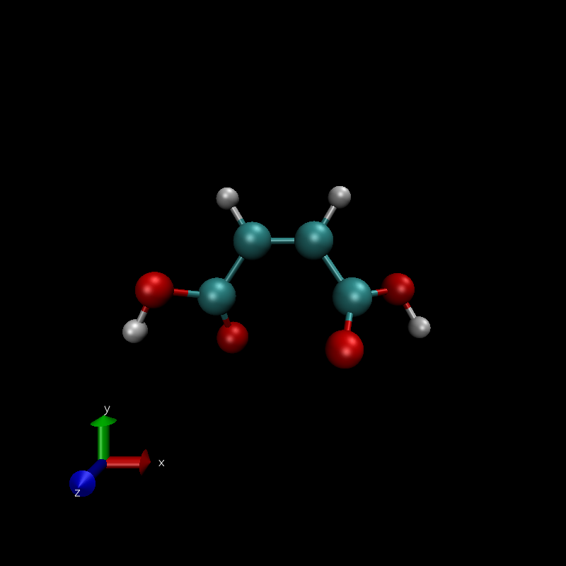
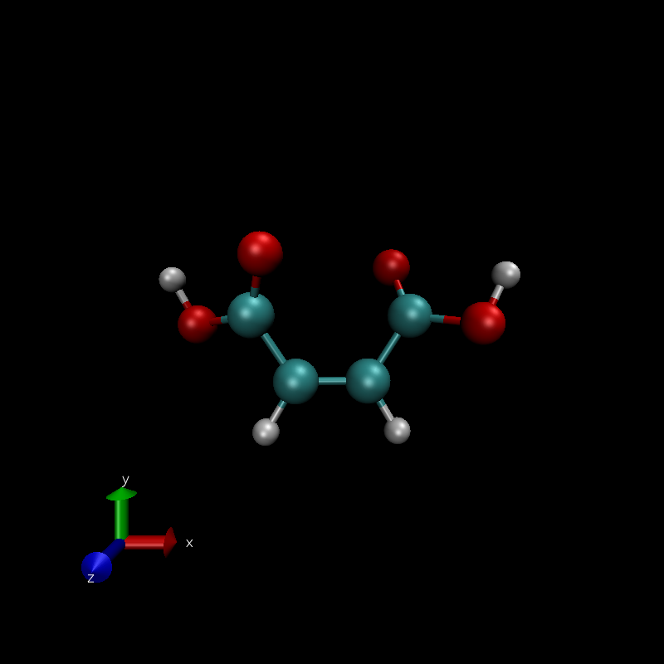

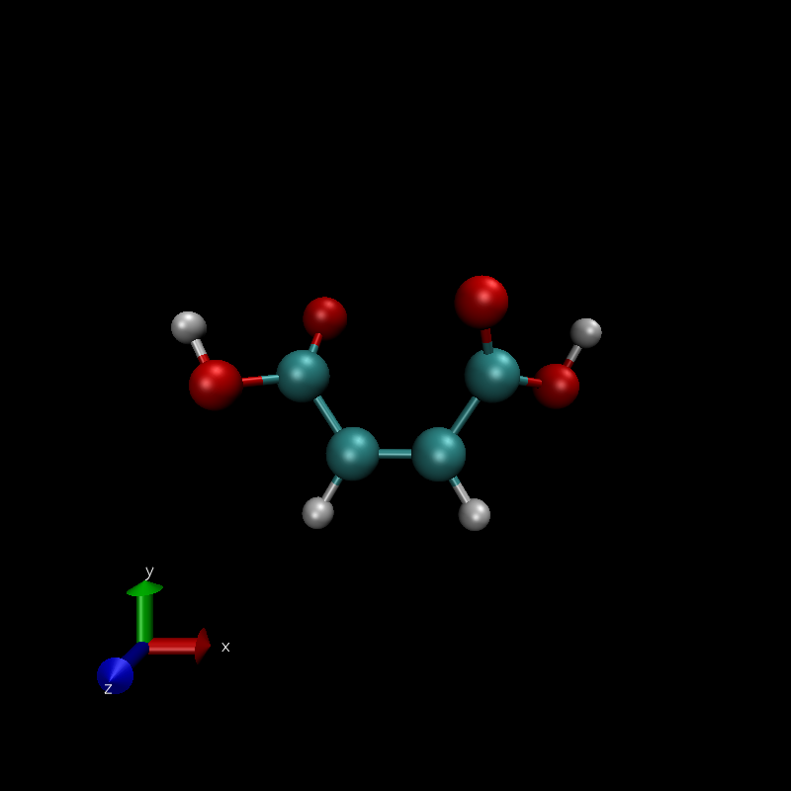



Maleic acid

Slide 26
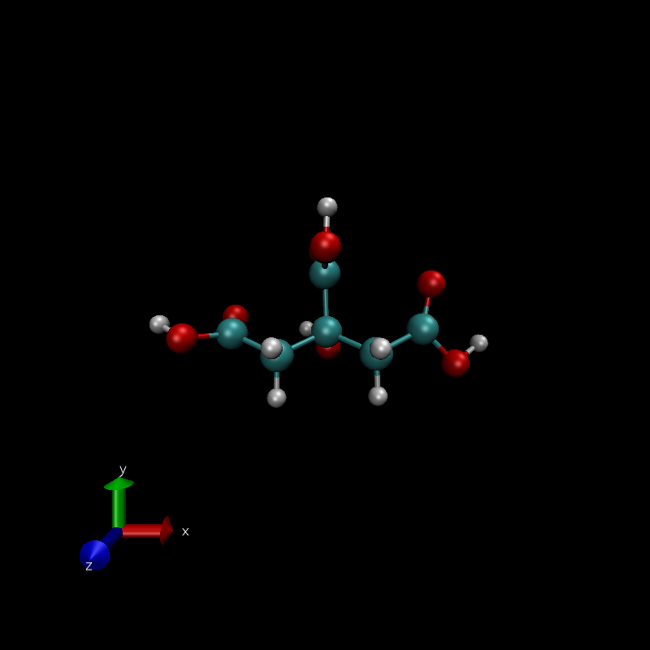
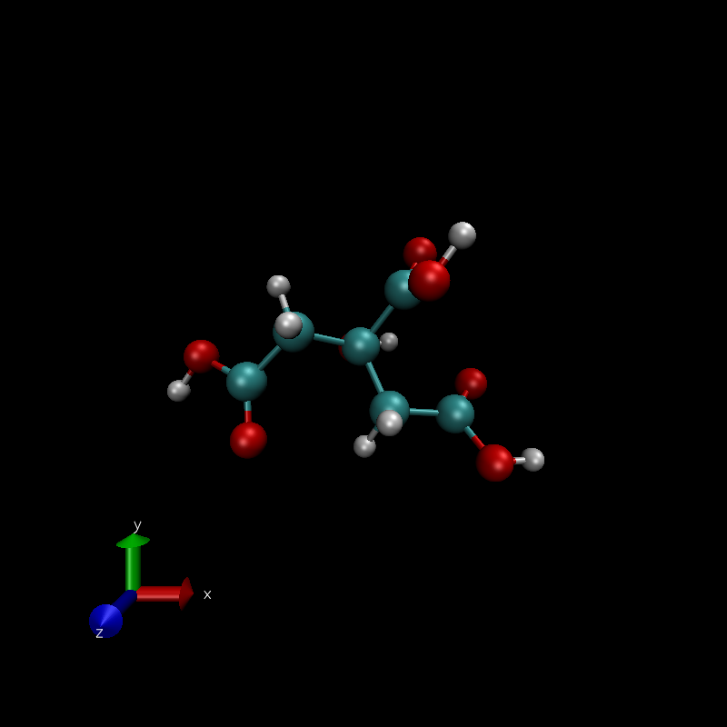


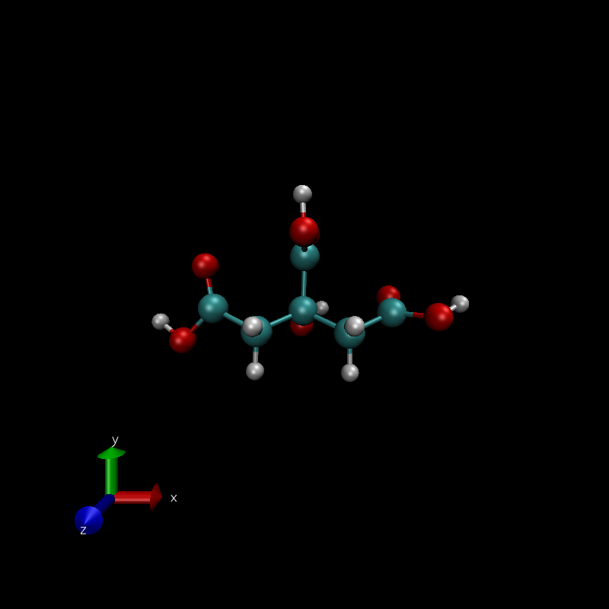

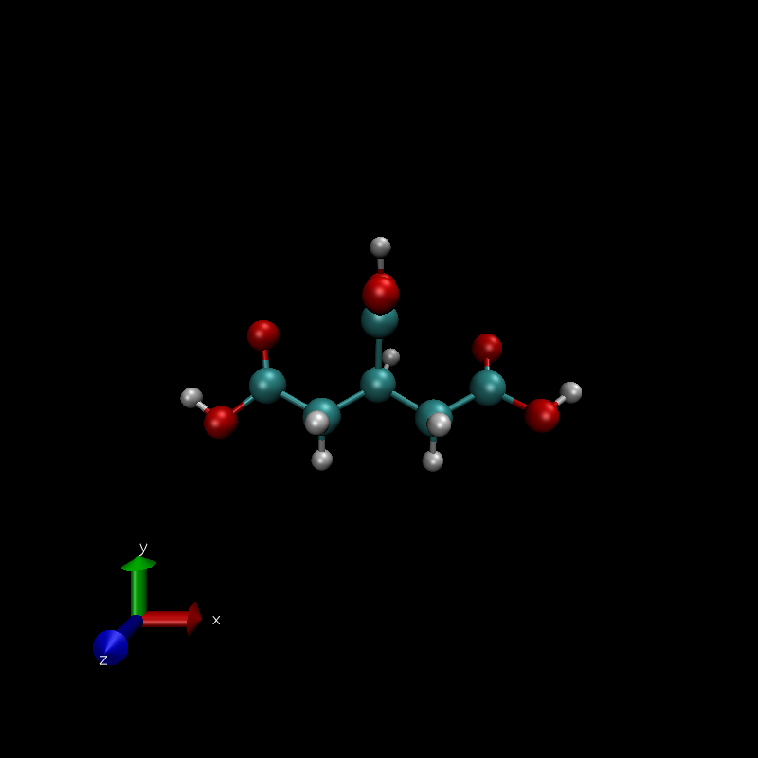
Citric acid

Slide 27
Global Definition 2
Global optimum is the position of the maximum normalized sum

Slide 28


Slide 29


Slide 30


Slide 31


Slide 32


Separate Loss Functions

Slide 33


Combined Loss Functions

Slide 34
C30

Slide 35
cis-But-2-ene

Slide 36
Phenolic acid

Slide 37
Styrene

Slide 38
Glycerol

Slide 39
Pentan-2-ol

Slide 40
Heptan-4-ol

Slide 41
But-2-en-1one

Slide 42
Ethylene glycol

Slide 43
Propanoic acid

Slide 44
Urea

Slide 45
Pent-3-one

Slide 46
3,4-dihydroxyacetophenone

Slide 47
prop-1-yne 3-one

Slide 48
Tetrahydrofuran-3-ol

Slide 49




Malic acid

Slide 50
Maleic acid

Slide 51
Citric acid

Slide 52

Global Definition 3
Global optimum is the position of the maximum normalized sum
Capping the range of the arrays to $±2σ$

Slide 53


Slide 56




Slide 57
Separate Loss Functions

Slide 58
Combined Loss Functions

Slide 59
C30

Slide 60
cis-But-2-ene

Slide 61
Phenolic acid

Slide 62
Styrene

Slide 63
Glycerol

Slide 64
Pentan-2-ol

Slide 65
Heptan-4-ol

Slide 66
But-2-en-1one

Slide 67
Ethylene glycol

Slide 68
Propanoic acid

Slide 69
Urea

Slide 70
Pent-3-one

Slide 71
3,4-dihydroxyacetophenone

Slide 72
prop-1-yne 3-one

Slide 73
Tetrahydrofuran-3-ol

Slide 74



Malic acid

Slide 75





Maleic acid

Slide 76







Citric acid

Slide 77

Global Definition 4
Attempting to only look at the unbonded components of $E_{MMFF}$ instead of all of them
(mostly to address the issues with dihydroxyacetophenone)

Slide 78




Example of Energy Components for 3,4-dihydroxyacetophenone
Undesired Conformer
(With Hydrogen Bonds)
Desired Conformer
(No Hydrogen Bonds)
Standard FF energy should be doing the trick
The problem is global parameter selection.
$E_{MMFF}=19.971$
$E_{VdW}= 6912.468$
$E_{elec}= −120.160$
$E_{VdW}+E_{elec}= 6792.308$
$E_{MMFF} = 27.895$
$E_{VdW}= 6895.4627$
$E_{elec}= −118.734$
$E_{VdW}+E_{elec}= 6776.730$
Even though H-Bonds are VdW interactions, maximizing electrostatic energy seems like it might be a better indicator of minimizing internal H-Bonding

Slide 79






Example of Energy Components for Heptan-4-ol
Undesired Conformer
($P_{HBC−HBC}=37, P_{HBC−R}=37$)
Desired Conformer
($P_{HBC−HBC}=1, P_{HBC−R}=1$)
$$E_{MMFF}= 4.135$$
$$E_{VdW}= 6353.715$$
$$E_{elec}= −35.172$$
$$E_{VdW}+E_{elec}= 6318.543$$
$$SASA=222.6$$
$$E_{MMFF}= 1.045$$
$$E_{VdW}= 6357.246$$
$$E_{elec}= −34.920$$
$$E_{VdW}+E_{elec}=6322.324$$
$$SASA=225.3$$
SASA might be a better metric for molecules with only 1 HB-capable group.
Combining metrics seems to fail because the ranges for SASA and $E_{MMFF}$ are too different.

Slide 80
Global Definition 5
Attempting to only look at the unbonded components of $E_{MMFF}$ instead of all of them
(mostly to address the issues with dihydroxyacetophenone)

